Slide 1
Machine Learning DSE 2254
Rohini R. Rao & Manjunath Hegde
Department of Data Science and Computer Applications
MIT, Manipal
March 2022
Slide Set 1 – ML Concepts

Slide 2
Contents
History
Definition of ML
Types of Learning
Supervised Learning
Unsupervised Learning
Reinforcement Learning
Terminology
Hypothesis Space
Inductive Bias
Inductive Learning & Generalization
Model Evaluation & Selection
Bias & Variance
Parametric vs. Non Parametric Models
Model Selection
No free lunch theories

Slide 3
History
1950s – Arthur Samuel’s checkers playing games
1960s
Rosenblatt proposed a perceptron
Delta Learning Rule
Minsky and Papert
1970s
Symbolic concept of Induction
Expert systems
Ross Quinlan’s ID3
Symbolic Natural Language Processing
Notes:
Machine which is as capable as humans. Artificial Intelligence .
The main driver of the machine was a search tree of the board positions reachable from the current state. Since he had only a very limited amount of available computer memory, Samuel implemented what is now called alpha-beta pruning
Rosenblatt – perceptron illustrates fundamental properties of intelligent systems, without becoming enmeshed in special and frequently unknown conditions. an electronic device which was constructed with biological principles and showed an ability to learn. initially simulated on an IBM 704 computer at Cornell Aeronautical Laboratory in 1957.^{[7]} When a triangle was held before the perceptron's eye, it would pick up the image and convey it along a random succession of lines to the response units, where the image was registered
Delta learning rule or least square problem- the delta rule is a gradient descent learning rule for updating the weights of the inputs to artificial neurons in a single-layer neural network.
Induction where a system tries to induce a general rule from a set of observed instances.
Minsky – limitations of perceptron, said the perceptron cannot handle XOR problem , inseperable data distributions cannot be handled.
Symbolic AI uses human-readable symbols that represent real-world entities or concepts as well as logic (the mathematically provable logical methods) in order to create ‘rules’ for the concrete manipulation of those symbols, leading to a rule-based system.

Slide 4
History
1980s
Advanced Decision Trees and Rule Learning
Resurgence in Neural Networks – Back Propagation
Werbos - Multilayer Perceptron Networks
Valiant’s Probably Approximate Correct Learning (PAC) Learning Theory – experimental methodology
1990s
Vapnik, Cortes – Support Vector Machines, Kernels in 2000
Data Mining
Freund & Shapire – ADA Boost – create a strong classifier from an ensemble of weak classifiers
Bremen - Random Forest - 2001
Bayes Net
Adaptive Agents and Web Applications
Notes:
Williams and Neilson worked on Back Propogation.
Valiant’s
SVM had empirical results.

Slide 5
History
2000s
Deep Learning
New Hardware – GPUS
Cloud Enabled
Availability of Big Data
Milestones
1997 – Deep Blue beat Gary Kasparov in a game of chess
2009 – Google built Self Driving Cars
2011 – IBM’s Watson won the popular game of jeopardy
2014 – Human Vision surpassed by ML vision

Slide 6
Programmatic Vs. Machine Learning Solution
Data Program
Output
Data Output
Program or Learning
to solve subsequent tasks
COMPUTER
COMPUTER

Slide 7
Formal Definition of Machine Learning
Arthur Samuel (1959).
Field of study that gives computers the ability to learn without being explicitly programmed.
Tom Mitchel (1998)
A computer program is said to learn
from experience E
with respect to some task T
and some performance measure P,
if its performance on T, as measured by P, improves with experience E.
Notes:
Suppose your email program watches which emails you do or do not mark as spam, and based on that learns how to better filter spam. What is the task T in this setting?
“

Slide 8
Definition of Machine Learning
Experiences/Data
Problem/Task
LEARNER
Models
REASONER
Background Knowledge/Bias
Answer/Performance
Notes:
We have to choose the training data. What is the target function or how to represent the model. Ex – given a board position what move to make.
Choose a learning algorithm that will infer the target function

Slide 9
Types of Learning
Supervised learning
predict y from x
Given a labelled set of input-output pairs, Map input x to output y
Given: Training set {(x_{i} , y_{i} ) | i = 1 … n}
Find: A good approximation to
f : X → Y where y ∈ {1, . . . , C},
Classification – y is categorical
Regression – y is real values
Formalize the problem is as function approximation.
y = f(x) for some unknown function f
goal of learning is to estimate the function f
given a labeled training set
then to make predictions using ˆy = ˆ f(x).
Generalization-to make predictions on novel inputs
Examples - spam detection, Digit Recognition, stock prices

Slide 10
Supervised Learning

Slide 11
Supervised Learning- example - IRIS

Slide 12
Types of Learning
Unsupervised learning
model p(x), evaluate how likely x is, understand x
Find interesting patterns or knowledge discovery
clustering, patterns

Slide 13
Unsupervised Learning – example- grouping

Slide 14
Types of Learning
Reinforcement learning
Agent is acting in an environment.
Needs learn action to take at every step
Action depends on reward or punishment signals that the agent gets in each state
Notes:
Rlearner learns policy. Not only for short term reward but overall utility of agent over time horizon is optimized

Slide 15
Terminology
Feature Space represents the data in a set of n features
Features are properties that describe each instance in Instance space
Multiple features represented in a Feature Vector
We are given data and induction identifies a function, which can explain the data.
Hypothesis could be a function which is a line or curve which separates classes.
Hypothesis Space
is the set of all legal functions that are solutions to the task
Comprises of the features chosen and the language or the class of functions

Slide 16
Terminology

Slide 17
Hypothesis language - representations

Slide 18
Inductive Bias
Need to make assumptions
Experience alone does not allow us to make conclusions about unseen data instances
Examples
Occam’s Razor
prefer the simplest hypothesis.
Philosophical principle that if something can be described in a short language that hypothesis is to be preferred over a more complex hypothesis.
minimum description length
Maximum margin
Two types of Bias
Restriction :
Limit the Hypothesis space
For instance, Hypothesis language reflects the inductive bias of the learner
Preference
Impose ordering on Hypothesis Space

Slide 19
Inductive Learning
Inducing a general function from training examples.
Given some training examples, the objective is to generalize to test data
Construct hypothesis h to agree with c on the training examples.
Consistent Hypothesis agrees with all training examples.
hypothesis that is consistence with all the training examples
A hypothesis is said to generalize well if it correctly predicts the value of y for novel example.
Inductive Learning is an ill posed problem
where the data by itself is not sufficient to find a unique solutions
inductive learning hypothesis
A hypothesis which has a low training error over a sufficiently large training set is expected to do well on unseen examples.

Slide 20
Formal Definition of Learning
function approximation.
We assume y = f(x) for
some unknown function f
The goal of learning is to estimate the function f
given a labeled training set
then to make predictions using ŷ = f(x).
Generalization
to make predictions on novel inputs, meaning ones that we have not seen before
Leslie Kielbling

Slide 21
Need for Probabilistic Prediction
the probability distribution over possible labels
given the input vector x and training set D is p(y|x,D)
If there are just two classes
it is sufficient to return the single number p(y = 1|x,D)
since p(y = 1|x,D) + p(y =0|x,D) = 1.)
MAP Estimate (Maximum A Posteriori estimate)
Most probable class

Slide 22
Experimental Evaluation of Learning Algorithms
Evaluating the performance of learning systems is important because
Learning systems are designed to predict the class of future unlabeled data points
Experimental Model Evaluation include
Error
Accuracy
Precision/Recall
Typical Choices for Sampling Methods
Train/test sets
Error or other parameters is measured on the training set
the error or accuracy on the training set is not, may not be a reflection of the true error
K-fold Cross-validation

Slide 23
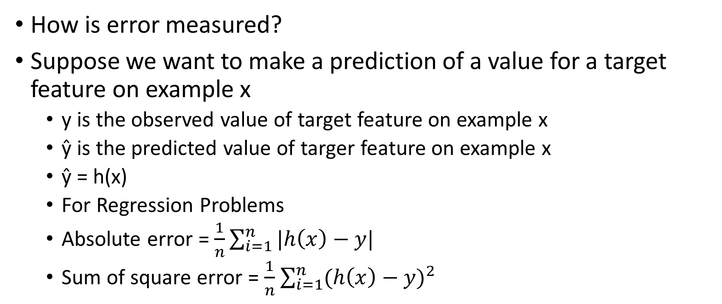
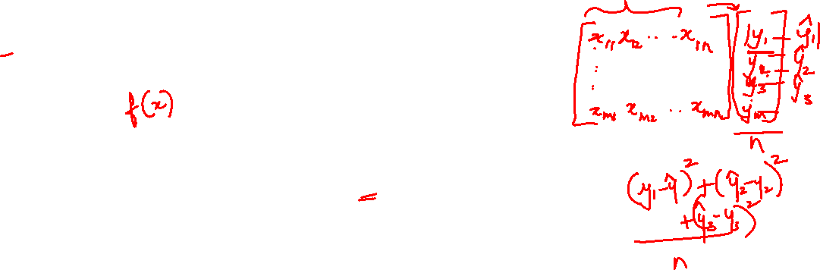
Experimental Model Evaluation for Prediction
How is error measured?
Suppose we want to make a prediction of a value for a target feature on example x
y is the observed value of target feature on example x
ŷ is the predicted value of targer feature on example x
ŷ = h(x)
For Regression Problems
Absolute error = $\frac{1}{n}\sum_{i=1}^{n}{|h\left(x\right)−y|}$
Sum of square error = $\frac{1}{n}$ $\sum_{i=1}^{n}{{(h\left(x\right)−y)}^{2}}$

Slide 24
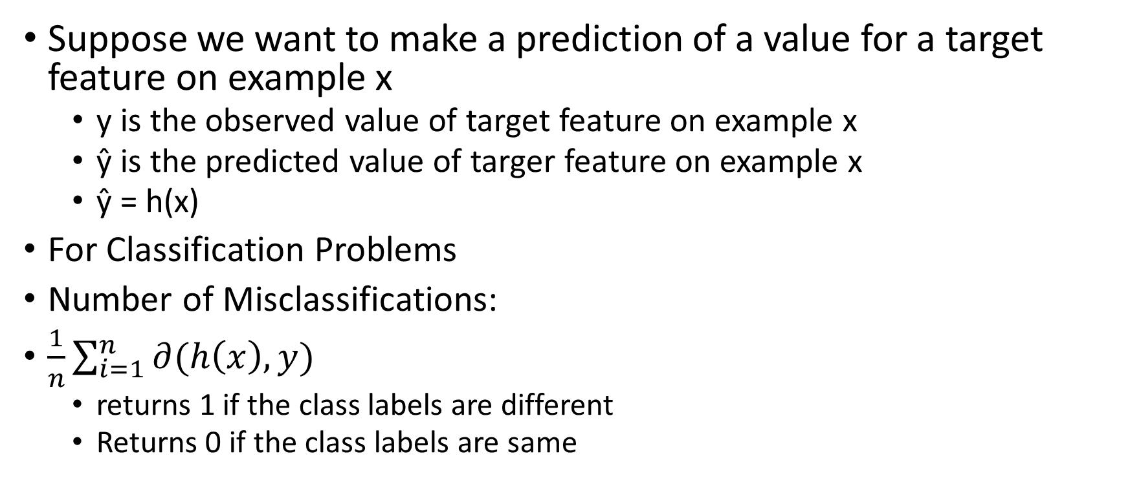
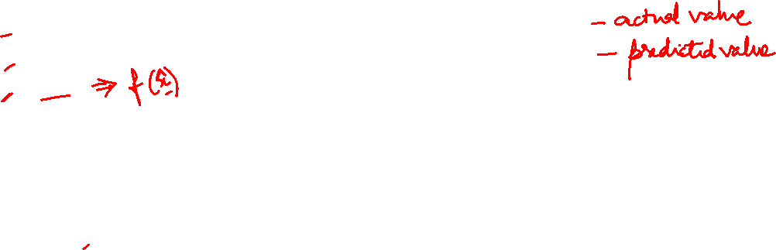
Experimental Model Evaluation for classification
Suppose we want to make a prediction of a value for a target feature on example x
y is the observed value of target feature on example x
ŷ is the predicted value of targer feature on example x
ŷ = h(x)
For Classification Problems
Number of Misclassifications:
$\frac{1}{n}\sum_{i=1}^{n}{∂(h\left(x\right),y)}$
returns 1 if the class labels are different
Returns 0 if the class labels are same

Slide 25


Model Evaluation in Classification
Accuracy = $\frac{TP+TN}{P+N}$
Precision = $\frac{TP}{TP+FP}$
Recall =$\frac{TP}{P}$
True Class ------------------------------------→
Hypothesis Class-→
TP | FP
FN | TN
P
N

Slide 26
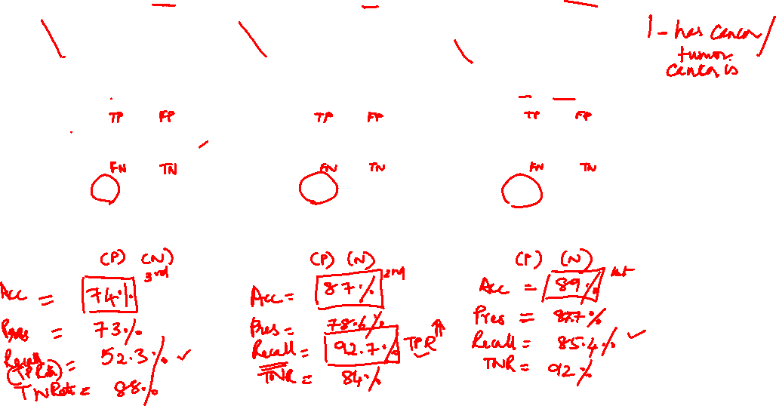
Ex 1 - Compare models

Slide 27
Typical Choices for Sampling Methods K fold cross validation
Validation set used to tune model parameters

Slide 28
Model Selection in the KNN case
We care about generalization error or test error
Test error (Red Line)
U-shaped curve
for complex models (small K), the method overfits
simple models (big K), the method underfits
Use validation test to pick K
Pick the value with the minimum error on the test set
K = 10 to 100

Slide 29
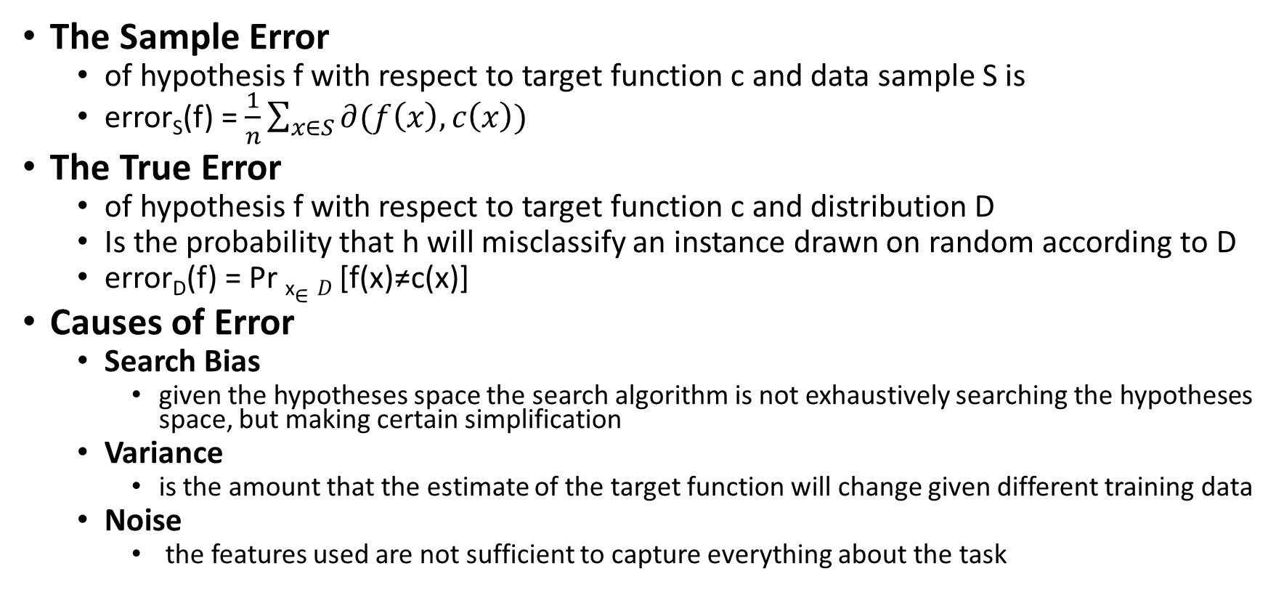
Sample Error vs True Error
The Sample Error
of hypothesis f with respect to target function c and data sample S is
error_{S}(f) = $\frac{1}{n}\sum_{x∈S}{∂(f\left(x\right),c\left(x\right))}$
The True Error
of hypothesis f with respect to target function c and distribution D
Is the probability that h will misclassify an instance drawn on random according to D
error_{D}(f) = Pr _{x}$∈D$ [f(x)≠c(x)]
Causes of Error
Search Bias
given the hypotheses space the search algorithm is not exhaustively searching the hypotheses space, but making certain simplification
Variance
is the amount that the estimate of the target function will change given different training data
Noise
the features used are not sufficient to capture everything about the task

Slide 30
Bias & Variance
Bias
is the simplifying assumptions made by the model to make the target function easier to approximate.
Variance
is the amount that the estimate of the target function will change given different training data.
If the test set is small there will be variance.
Trade-off is tension between the error introduced by the bias and the variance.

Slide 31
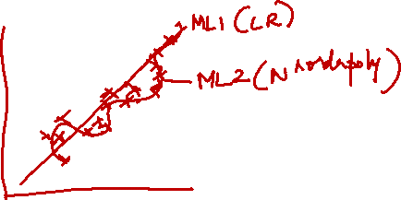
Machine Learning Trade-off
In ML there is always are trade-off between
Complex hypothesis that fit the training data well
Simpler hypothesis that may generalize better
As the amount of training data increases, the generalization error decreases
No Free Lunch Algorithm (Wolpert 1996).
All models are wrong, but some models are useful. — George Box (Box and Draper 1987
As a consequence of the no free lunch theorem
Need to develop many different types of models
to cover the wide variety of data that occurs in the real world.
For each model, there may be many different algorithms we can use to train the model
Then make speed-accuracy-complexity tradeoffs.

Slide 32
Developing a learning algorithm
To improve the learning algorithm

Slide 36
Bias vs. Variance

Slide 37
Bias Vs Variance

Slide 38
Diagnosing Bias vs Variance

Slide 39
Learning Curves

Slide 40
High Bias vs. High Variance

Slide 41
Solutions

Slide 42
Parametric vs Non Parametric Models
Parametric model
A learning model that summarizes data with a set of parameters of fixed size
independent of the number of training examples.
Faster to use
but making stronger assumptions
Examples
Linear Regression
Logistic Regression
Naive Bayes

Slide 43
Parametric vs Non Parametric Models
Nonparametric model
Model with lot of data and no prior knowledge
no need to choose the right features.
more flexible, but often computationally intractable
Examples
Decision Trees
K-Nearest Neighbor
Support Vector Machines

Slide 44
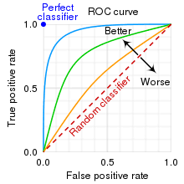
ROC
ROC
is plot of the false positive rate (x-axis) versus the true positive rate (y-axis) for a number of different candidate threshold values between 0.0 and 1.0.
False Positive Rate = 1 – Specificity
The area under the curve (AUC) can be used as a summary of the model skill.
A no-skill classifier is one that cannot discriminate between the classes
would predict a random class or a constant class in all cases.
has an AUC of 0.5.
A model with perfect skill is represented at a point (0,1).
Has AUC close to 1

Slide 45
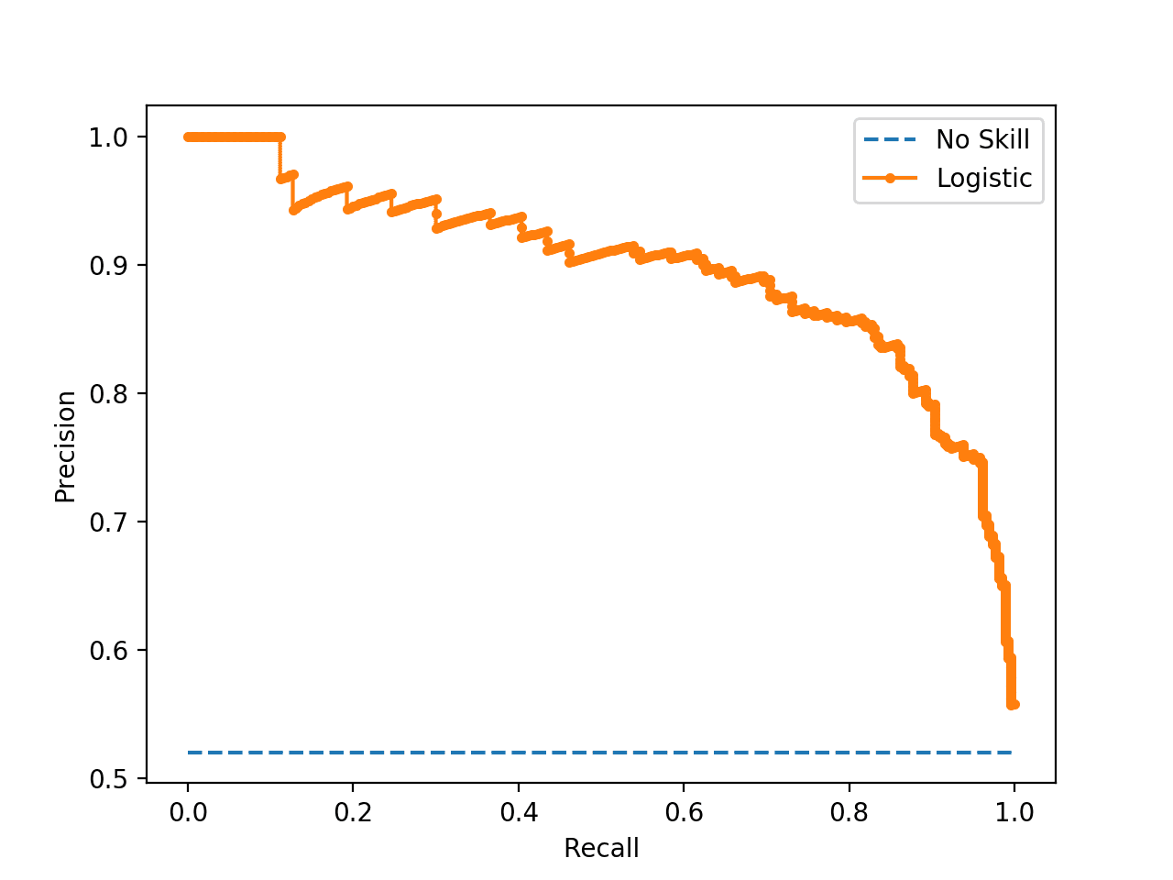
PRC
is a plot of the precision (y-axis) and the recall (x-axis) for different thresholds
Baseline is P/(P+N)
Precision
is a ratio of the number of TPs divided by the sum of TPs and FPs.
describes how good a model is at predicting the positive class.
Recall is Sensitivity
composite scores that attempt to summarize the precision and recall are:
F-Measure or F1 score- harmonic mean of the precision and recall
AUC (PRC)
summarizes the integral or an approximation of the area under the precision-recall curve.

Slide 46
Class Imbalance Problem
Rare classes have less than 10% of instances.
Most health datasets contain majority negative class and minority positive class
Target class has much lower precision and recall than majority class
In general , the algorithms preferred are:
instance based learning
SVM where decision boundaries are not affected by number of instances
MLP
Ensembling to aggregate predictions

Slide 47
Class Imbalance Problem
Preprocessing techniques
Under sampling
Over sampling
Synthetic Minority Over Sampling Technique (SMOTE)
Cost Benefit Analysis
The Cost matrix is used to represent the imbalance
For instance, the cost of FNs can be 10 times more than the cost of the FP
Cost function to be minimized, as well as reduce the number of FNs or high recall is desirable

Slide 48
Ensemble Learning
general meta approach to machine learning that seeks better predictive performance by combining the predictions from multiple models.
Ensembles overcome three problems Dietterich(2002) –
Statistical Problem
hypothesis space is too large for the amount of available data.
many hypotheses with the same accuracy on the data
risk that the accuracy of the chosen hypothesis is low on unseen data!
Computational Problem
the learning algorithm cannot guarantee finding the best hypothesis.
Representational Problem
the hypothesis space does not contain any good approximation of the target class(es).

Slide 49
Simple Ensembling Techniques
Max Voting
Mostly used for classification
multiple models are used to make predictions for each data point.
The predictions by each model are considered as a ‘vote’.
The predictions which we get from the majority of the models are used as the final prediction.
Averaging
can be used for making predictions in regression or while calculating probabilities for classification
multiple predictions are made for each data point
an average of predictions from all the models and use it to make the final prediction.
Weighted Average
an extension of the averaging method.
All models are assigned different weights defining the importance of each model for prediction.

Slide 50
Standard ensembling techniques include
Bagging
involves fitting many decision trees on different samples of the same dataset and averaging the predictions.
Stacking
involves fitting many different models types on the same data
and using another model to learn how to best combine the predictions.
Boosting
involves adding ensemble members sequentially that correct the predictions made by prior models and outputs a weighted average of the predictions.

Slide 51
Ensembling in general
The variance of the general model decreases significantly thanks to bagging
The bias also decreases due to boosting
And overall predictive power improves because of stacking
Sequential ensemble methods
use the dependency between base learners.
A popular example of sequential ensemble algorithms is AdaBoost.
Parallel ensemble methods
The base learners are created independently to study
Exploit the effects related to their independence and reduce error by averaging the results.
An example implementing this approach is Random Forest.

Slide 52
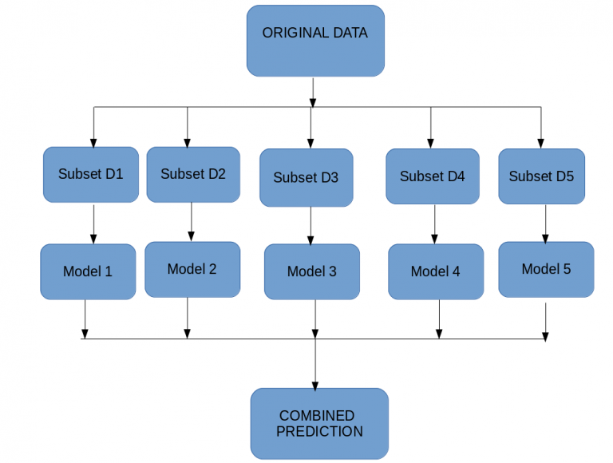
Bagging
Bootstrapping
is a sampling technique in which we create subsets of observations from the original dataset, with replacement.
The total size of the subsets is the same as the size of the original set.
Bagging (or Bootstrap Aggregating)
uses these subsets (bags) to get a fair idea of the distribution (complete set).
The total size of subsets created for bagging may be less than the original set.

Slide 53
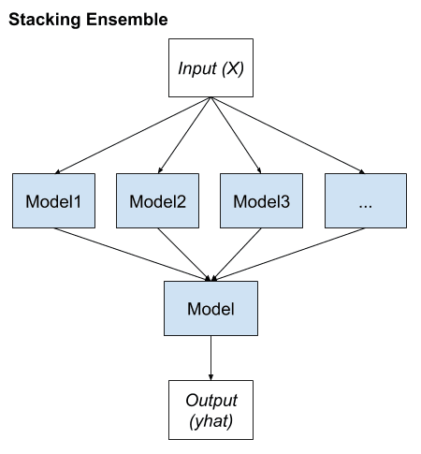
Stacking
seeks a diverse group of members by varying the model types fit on the training data and using a model to combine predictions.
level-0 models are ensemble members
level-1 model is used to combine the predictions

Slide 54
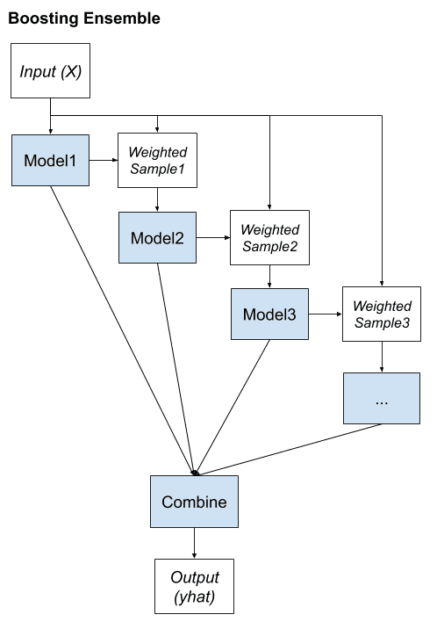
Boosting
key property is the idea of correcting prediction errors.
seeks to change the training data to focus attention on examples that previous models were not able to predict
Steps include :
Bias training data toward those examples that are hard to predict.
Iteratively add ensemble members to correct predictions of prior models.
Combine predictions using a weighted average of models.

Slide 55
Steps in Boosting
A subset is created from the original dataset.
Initially, all data points are given equal weights.
A base model is created on this subset.
This model is used to make predictions on the whole dataset.
Errors are calculated using the actual values and predicted values.
The observations which are incorrectly predicted, are given higher weights.
Another model is created and predictions are made on the dataset.
Similarly, multiple models are created, each correcting the errors of the previous model.
The final model (strong learner) is the weighted mean of all the models (weak learners).

Slide 56
Popular Boosting algorithms
Gradient Boost
used in regression and classification tasks
prediction model in the form of an ensemble of weak prediction models
The target outcome for each instance in the data depends on how much changing that prediction impacts the overall prediction error:
If a small change in the prediction for a instance causes a large drop in error, then next target outcome of the instance is a high value.
If a small change in the prediction for a instance causes no change in error, then next target outcome of the instance is zero.
Usually the base estimator is Decision Stump
used to minimize bias error of the model.
AdaBoost
short for Adaptive Boosting
is a statistical classification meta-algorithm
automatically adjusts its parameters to the data based on the actual performance in the current iteration.
Both the weights for re-weighting the data and the weights for the final aggregation are re-computed iteratively.
Is adaptive because subsequent weak learners are tweaked in favor of those instances misclassified by previous classifiers.

Slide 57
Popular Boosting algorithms
XG Boost
Parallelization: The model is implemented to train with multiple CPU cores.
Regularization: includes different regularization penalties to avoid overfitting. Penalty regularizations produce successful training so the model can generalize adequately.
Non-linearity: can detect and learn from non-linear data patterns.
Cross-validation: Built-in and comes out-of-the-box.
Scalability: can run distributed thanks to distributed servers and clusters like Hadoop and Spark, so you can process enormous amounts of data.
It’s also available for many programming languages like C++, JAVA, Python, and Julia.

Slide 58
Anomaly Detection (Outlier Detection)
is the process of finding data objects with behaviors that are very different from expectation.
Outlier detection and clustering analysis are two highly related tasks.
Clustering finds the majority patterns in a data set and organizes the data accordingly
Outlier detection tries to capture those exceptional cases that deviate substantially from the majority patterns
Different from Noisy data
Applications include:
Credit Card Fraud Detection
Network Intrusion
Type of Outliers
Global
contextual (or conditional)
collective

Slide 59
Global Outliers
a data object is a global outlier if it deviates significantly from the rest
of the data set.
are sometimes called point anomalies
Example :
Intrusion detection in computer networks
If the communication behavior of a computer is very different from the normal patterns (e.g., a large number of packages is broadcast in a short time)

Slide 60
Contextual Outliers
a data object that deviates significantly with respect to a specific context of the object.
also known as conditional outliers because they are conditional on the selected context.
divided into two groups:
Contextual attributes:
The contextual attributes of a data object define the object’ context.
Ex: Temperature based on date and location.
Behavioral attributes:
define the object’s characteristics, and are used to evaluate whether the object is an outlier in the context to which it belongs.
Ex: Temperature example based on the temperature, humidity, and pressure.

Slide 61
Collective Outliers
a subset of data objects forms a collective outlier if the objects as a whole deviate significantly from the entire data set.
Importantly, the individual data objects may not be outliers
to detect background knowledge of the relationship among data objects such as distance or similarity measurements between objects has to be considered
Example
If one shipment is delayed, it may not be considered an outlier
However, if 100 orders are delayed on a single day, they can whole form an outlier
Example
intrusion detection
a denial-of-service package from one computer to another is considered normal, and not an outlier at all. However, if several computers keep sending denial-of-service packages to each other, they as a whole should be considered as a collective outlier

Slide 62
Outlier Detection Methods
Statistical Methods
For a gaussian/normal distribution, the data points lying away from 3rd deviation can be considered as anomalies
Histogram-based Outlier Detection
assumes the feature independence and calculates the outlier score by building histograms
It is much faster than multivariate approaches, but at the cost of less precision
Local Correlation Integral (LOCI)
provides a LOCI plot for each point which summarizes a lot of the information about the data in the area around the point
It determines clusters, micro-clusters, their diameters, and their inter-cluster distances

Slide 63
Outlier Detection Methods
Classification based
Consider a training set that contains samples labeled as “normal” and others labeled as “outlier
Class imbalance - Number of normal samples likely far exceeds the number of outlier samples.
one-class model. That is, a classifier is built to describe only the normal class. Any samples that do not belong to the normal class are regarded as outliers.
Isolation Forest:
uses a random forest algorithm (decision trees)
Tries to split or divide the data points such that each observation gets isolated from the others.
the anomalies lie away from the cluster of data points
One Class SVM:
regular SVM algorithm tries to find a hyperplane that best separates the two classes of data points.
For one-class SVM where we have one class of data points, and the task is to predict a hypersphere that separates the cluster of data points from the anomalies
K Nearest Neighbor
For any data point, the distance to its kth nearest neighbor could be viewed as the outlying score
PyOD supports three kNN detectors:
Largest: Uses the distance of the kth neighbor as the outlier score
Mean: Uses the average of all k neighbors as the outlier score
Median: Uses the median of the distance to k neighbors as the outlier score

Slide 64
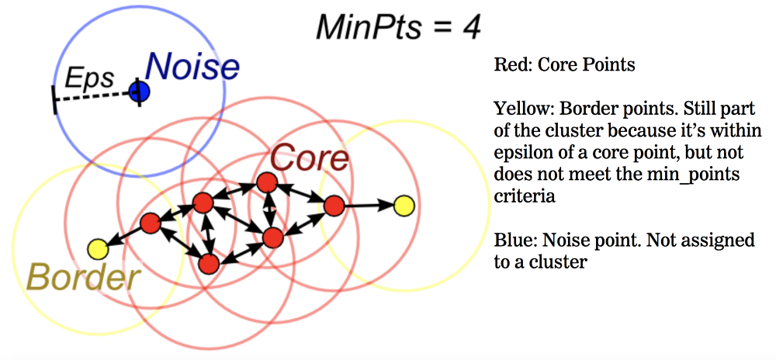
Outlier Detection Methods
Clustering based
Does the object belong to any cluster? If not, then it is identified as an outlier.
Is there a large distance between the object and the cluster to which it is closest? If yes, it is an outlier.
Is the object part of a small or sparse cluster? If yes, then all the objects in that cluster are outliers.
Using Distance Measures
Using density measures

Slide 65
References
Kevin P. Murphy, Machine Learning: A Probabilistic Perspective, MIT Press, 2012.
Introduction to Machine Learning – Prof. Sudeshna Sarkar,
Week 1: Introduction: Basic definitions, types of learning, hypothesis space and inductive bias, evaluation, cross-validation

